Slide 1
Pro
ManageHub
By TalentTech Innovations

Slide 2

PROJECT BY:
Anjali Kumar More anjalikmore.18@gmail.com
Rahul Bamane
rahulbamane09@gmail.com
Sakshi Naravankar
sakxnaravankar@gmail.com

Slide 3
CONTENTS
INTRODUCTION | Introduction about “ProManage Hub”
FEATURES & FUNCTIONALITY | Highlights ProManageHub's capabilities
DIAGRAMS FOR ProManageHub | Visual representations illustrating the system architecture and processes.
DESIGN AND IMPLEMENTATION | Strategies and Execution of ProManageHub's Development.
CONCLUSION | Summing up the Achievements and Implications of ProManageHub.

Slide 4
Introduction
In today's rapidly advancing technological landscape, automation has become integral to our daily lives. With an increasing workforce, managing data for a large number of employees within an organization has become imperative.
To address this challenge, we present the "ProManageHub" – a user-friendly solution designed to streamline record-keeping processes.
This project aims to revolutionize the conventional manual system by offering a software solution that not only simplifies data management but also mitigates the difficulties encountered in the current system.
Tailored to meet the specific needs of our company, this system ensures seamless and efficient operations.

Slide 5
Features & Functionality
See the list of Employee
Delete the records
Edit and Update the record
Add new Employee records
Employee Module

Slide 6
Features & Functionality -1
Admin can edit/delete the leave
Employee can see his leave
Admin can see the list of all leave
Admin can manage the leave
Leave Module

Slide 7
Features & Functionality -2
Admin can edit/delete the salary
Employee can see salary
Admin can see the list of all salary
Admin can manage the salary
Salary Module

Slide 8
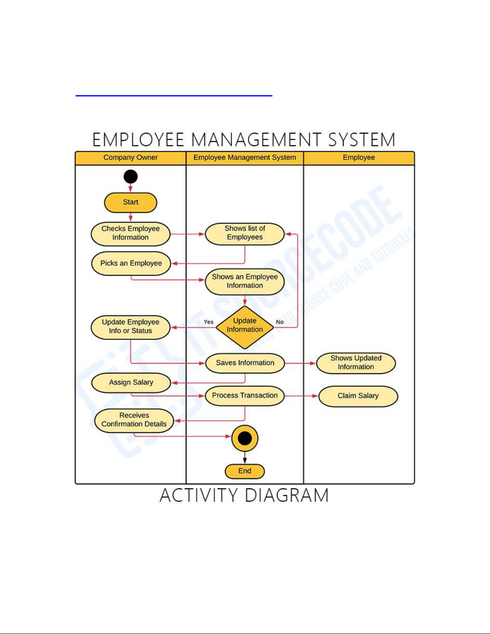
Diagrams for ProManageHub
Activity Diagram:

Slide 9
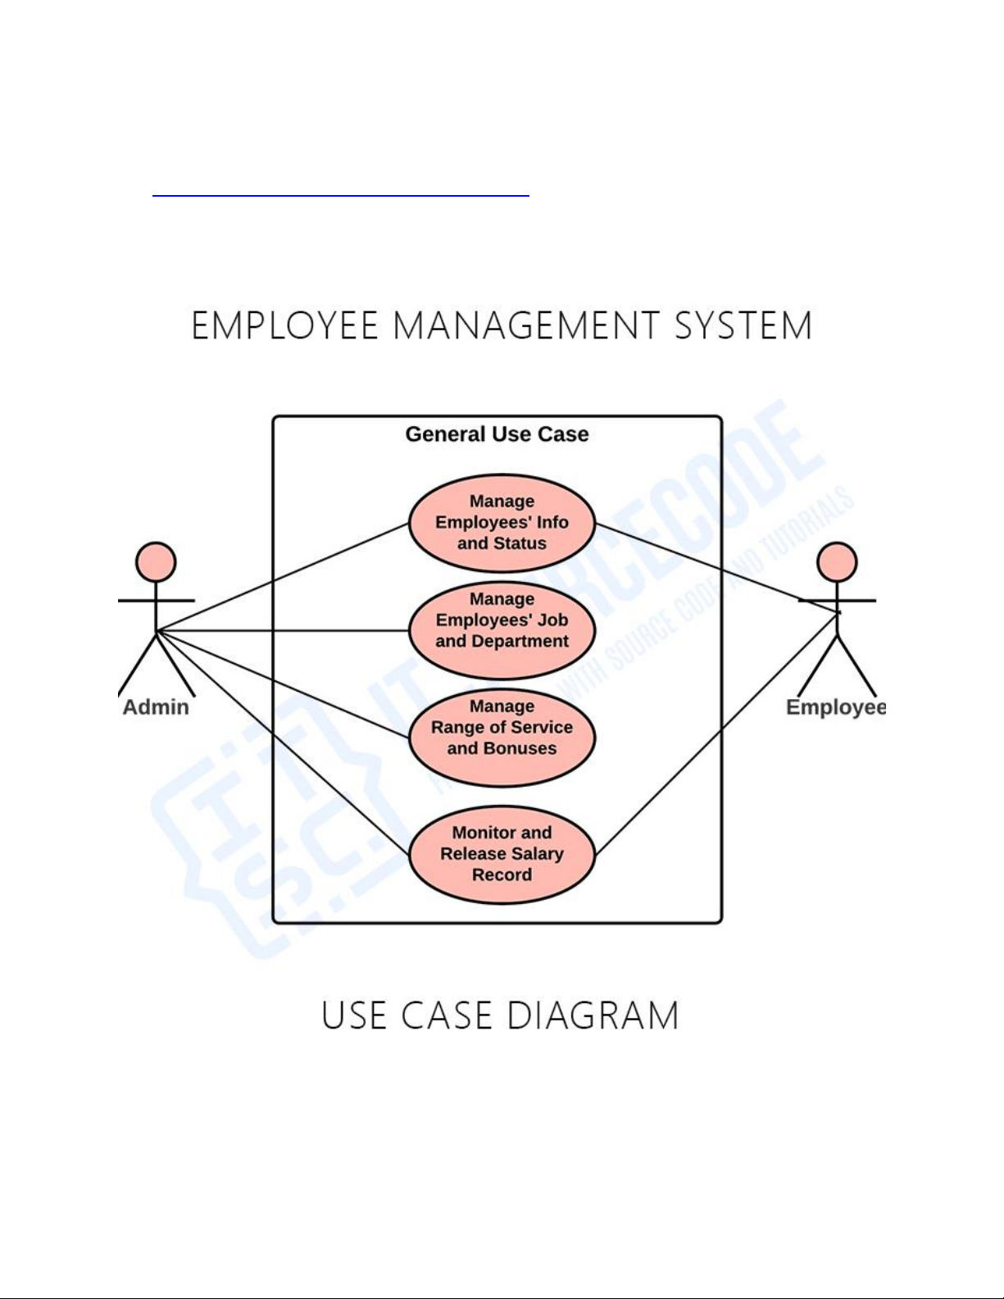
Diagrams for ProManageHub
Use Case Diagram:

Slide 10
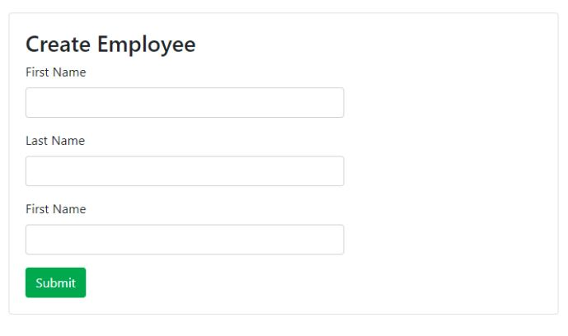
Design & Implementation
Create User:

Slide 11
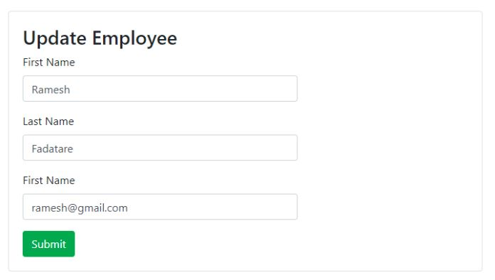
Design & Implementation
Update Record:

Slide 12
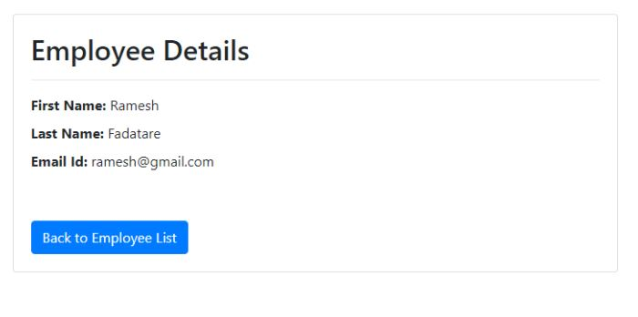
Design & Implementation
Display Record:

Slide 13
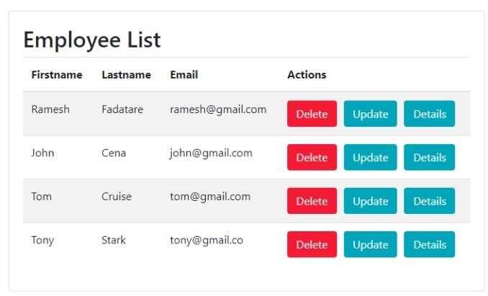
Design & Implementation
Manage Records:

Slide 14
CONCLUSION
"ProManageHub" represents a significant leap forward in modernizing our organizational operations. By leveraging cutting-edge technology, we have created a user-friendly platform that not only simplifies record-keeping but also addresses the challenges of managing a large workforce.
With its tailored design and error-preventing features, this system ensures smooth and efficient operations without the need for extensive training. The transition from manual processes to our automated solution promises increased productivity and accuracy in managing employee data.

Slide 15
Thanks!

